Slide 1


Slide 2
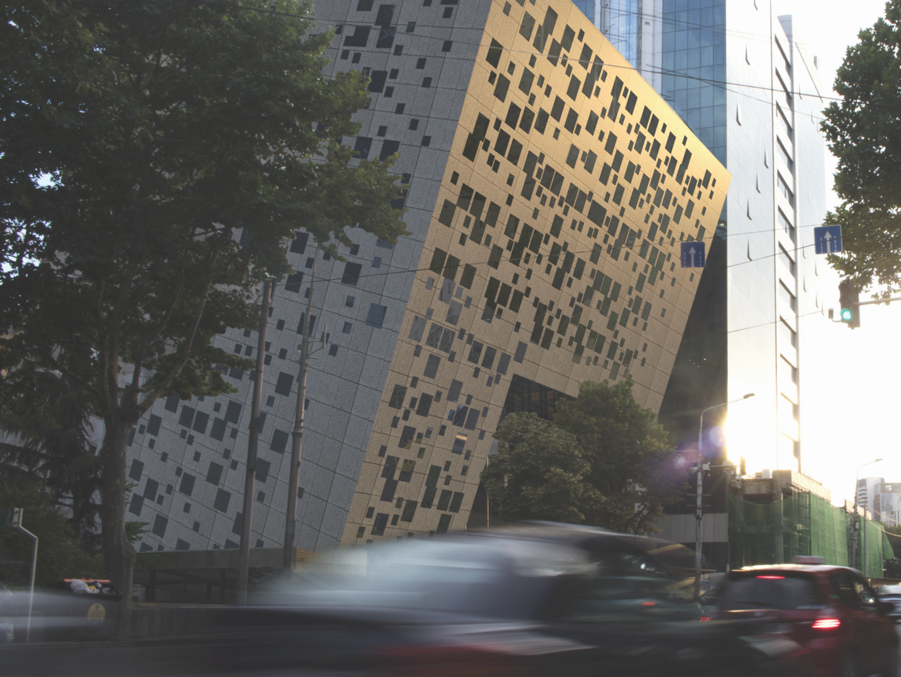
MORE THAN JUST ANOTHER OFFICE SPACE

Slide 3

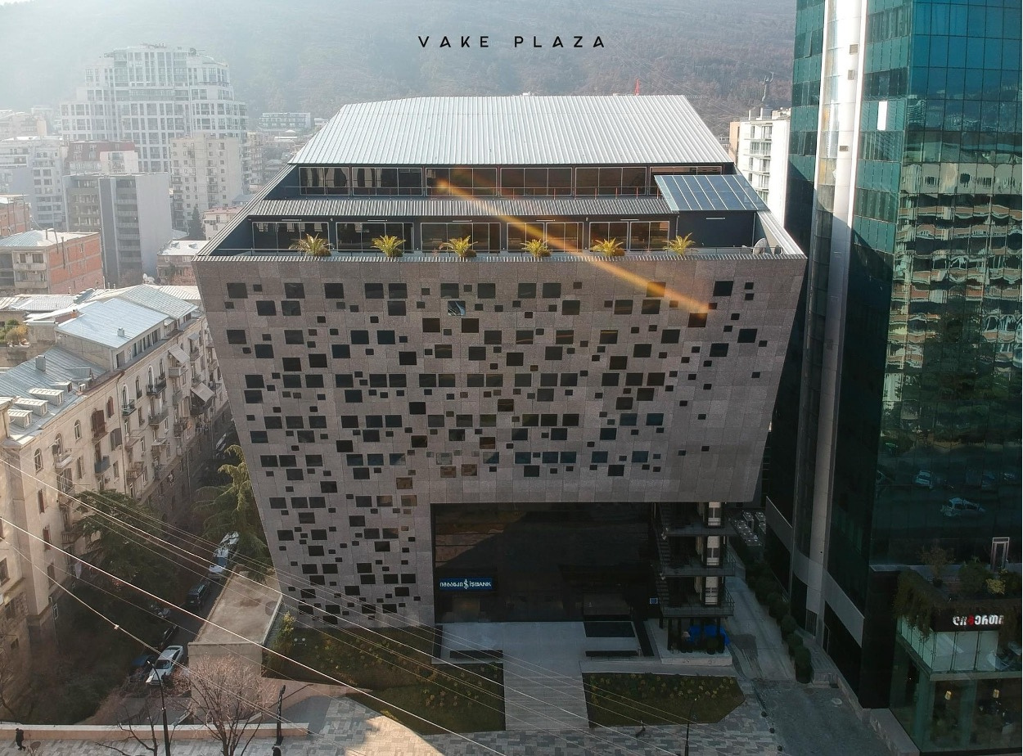

ABOUT US
More than just another office space
Vake Plaza is a fully managed multifunctional Business Center with uninterrupted power and water supply.
Conference venues
One of the largest parking spaces in the city centre

Slide 4
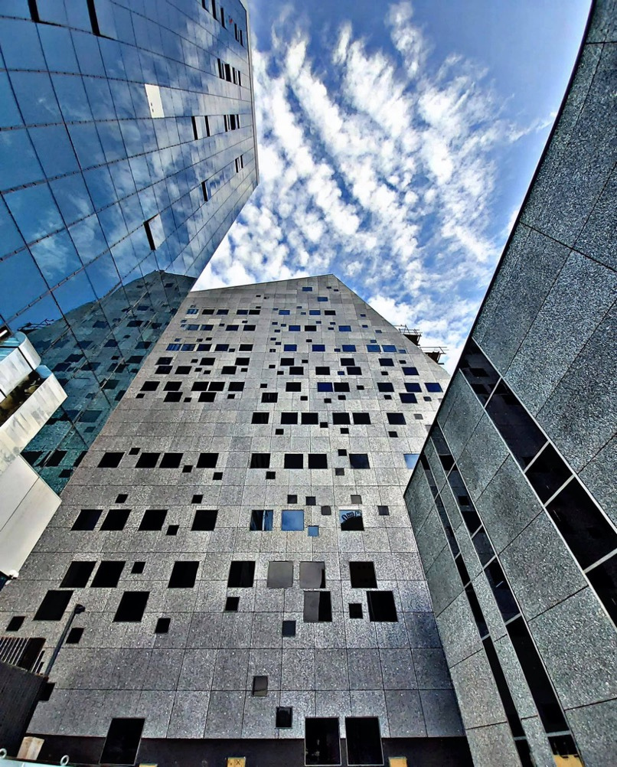
● Total Area - 24,500 m2
● Office space - 10,000 m2 GLA
● GLA per floor 1,000 m2
● 11 floors, 2 separate building
● Parking – 200 cars

Slide 5

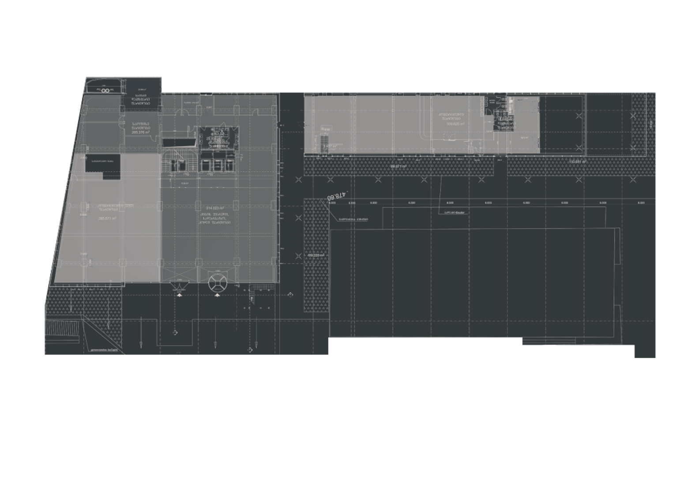
BUILDING PLAN

Slide 6


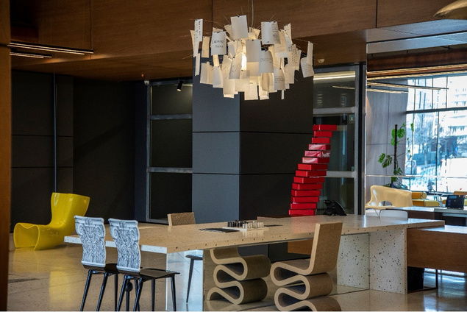
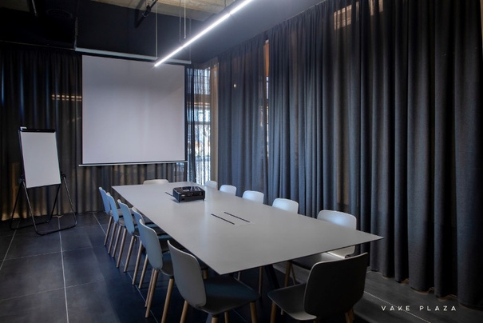
OUR SPACE
Lobby
Conference Spaces
Lobby seating area for relaxed meetings and talks
Multifunctional Conference spaces for presentations,
seminars,
or target-oriented project work

Slide 7

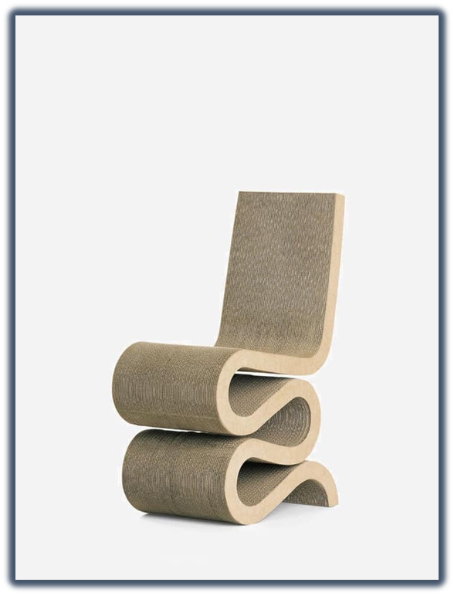
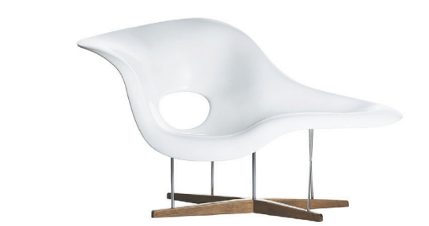
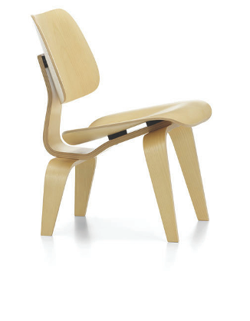
FEEL ICONIC
1
Wiggle Side Chair,
Frank Gehry 1972
3
2
Le Chaise,
Charles & Ray Eames, 1948
Plywood Group,
Charles & Ray Eames, 1945/1946

Slide 8

TECHNICAL DESCRIPTION
1
HVAC SYSTEM
•Ventilation Air Handling Unit (AHU) systems for fresh air supply;
• VRF systems for heating and cooling for each floor locally Mitsubishi Electric fan coil systems individually controllable office by office;
UNINTERRUPTED POWER SUPPLY
2 diesel generator
Clean Water Supply
Uninterrupted clean water supply with pumps and 20 Tone reservoir.
Uninterrupted power Supply (2000 kv.t power generator) and local in house power substation.
CCTV in Common areas and Parking
2
3
FIRE SECURITY SYSTEMS
•Each Floor is equipped with 4 fire hydrants with uninterrupted water supply.
• Fire Alarm Systems
• Smokefree staircase with fire resistant furnishing (walls, special glass partitions); Security Staircase with panic doors;
• Parking Space fully covered with sprinkler systems;
•Fire Resistant elevator
Totally adjusted to people with mobility impairment Special WC on each floor

Slide 9


Slide 10


CONTACT INFORMATION
SOFIA BRITANCHUK
CEO
sbritanchuk@vakeplaza.ge
+995 599550920

